Slide 1

Smart Retail
COTTON CANDY VENDING MACHINE
Franco Yao
Rockstream Automation Inc.
403-9880863
Franco_yao@163.com

Slide 2
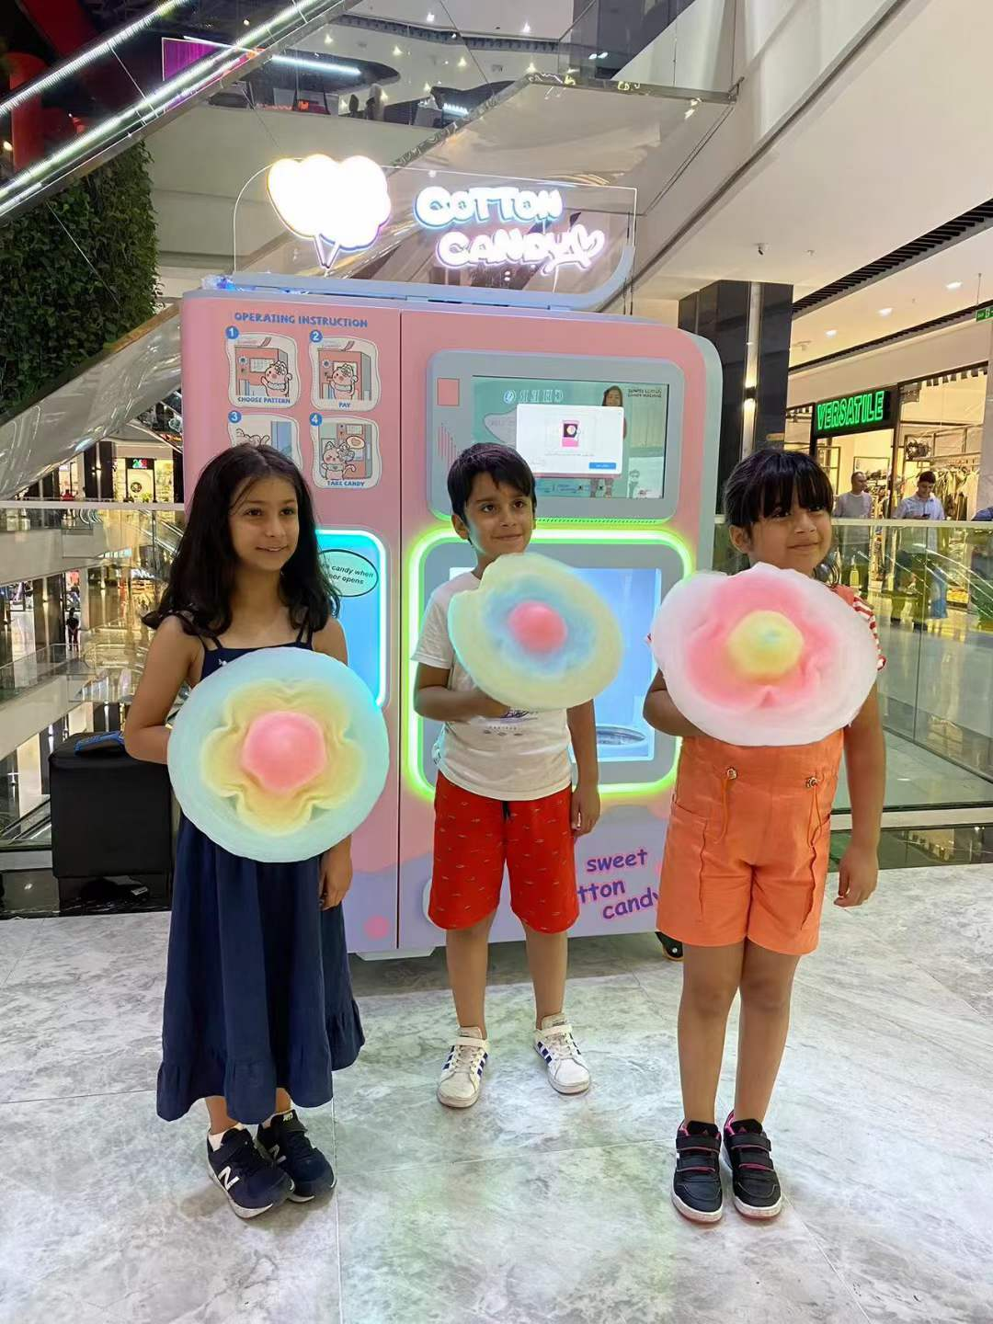
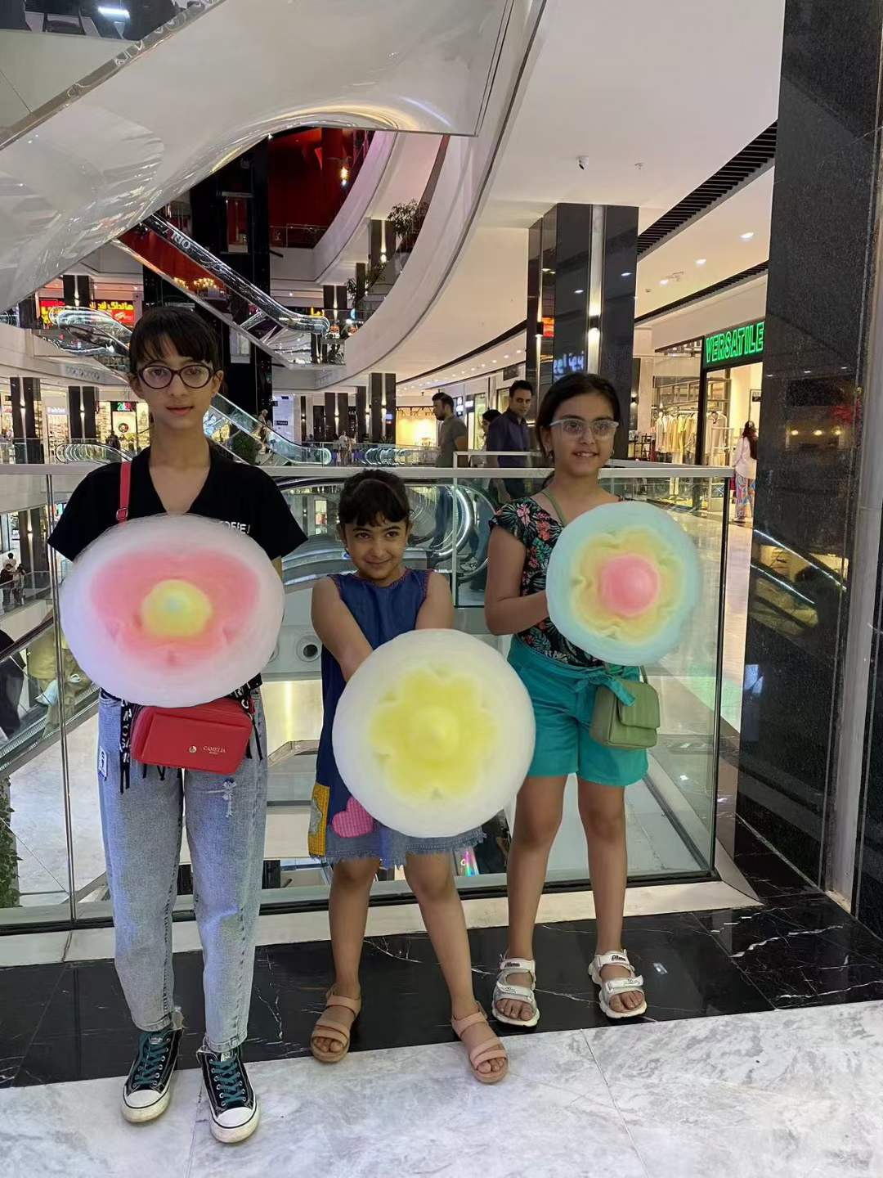
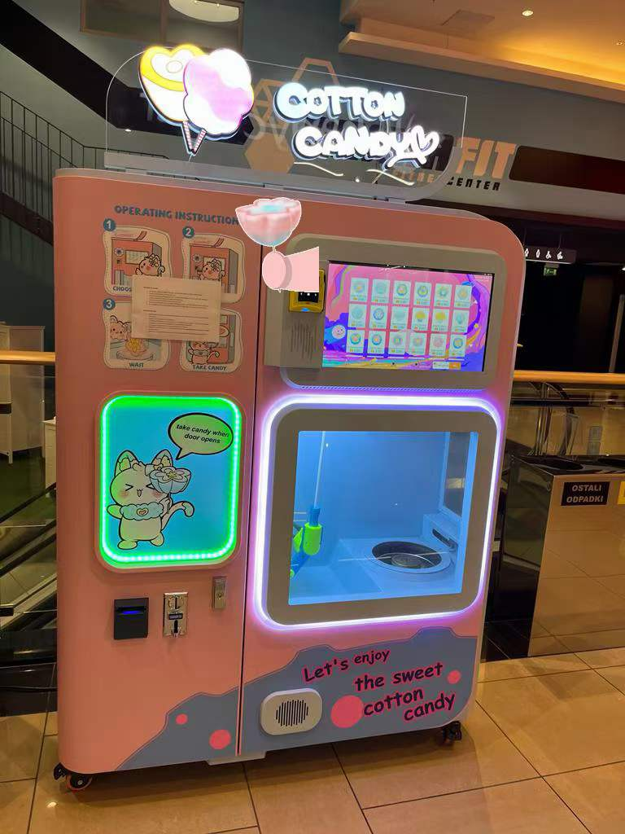
1. Our Product

Slide 3
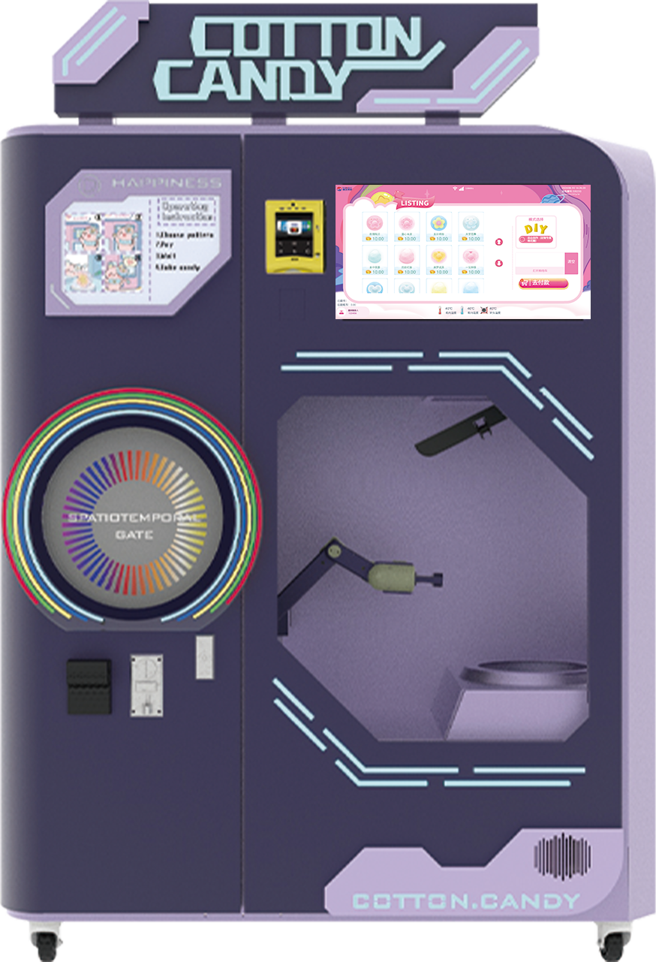
1. Machine A
Personalized light box
Operation screen (Support DIY)
Credit card payment
Pressing knife
Automated Door
Burner
Manipulator
Sugar bin

Slide 4
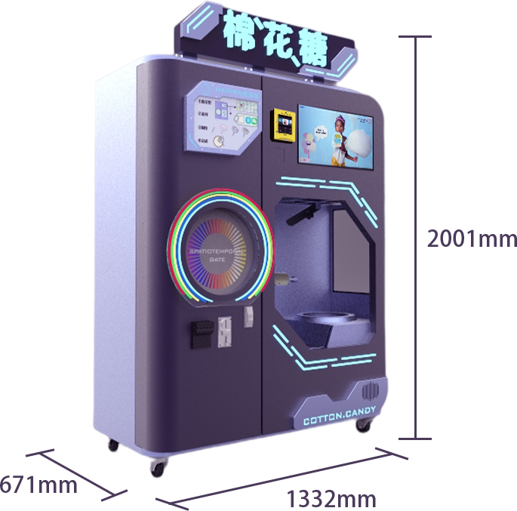
Basic parameters
Extermal dimension: 1332*671*2001mm
Machine weight: 210kg
Maximum power: 2700W
Rated Voltage: AC 220V/110V
Make Pattern: 60 Kinds
Time ofcandy making: 70-130S
Full material to make sugar: 200-250
Use environment: 0-50℃
Due to the continuous upgrade of the equipment version, the data parameters shall be subject to the actual equipment

Slide 5
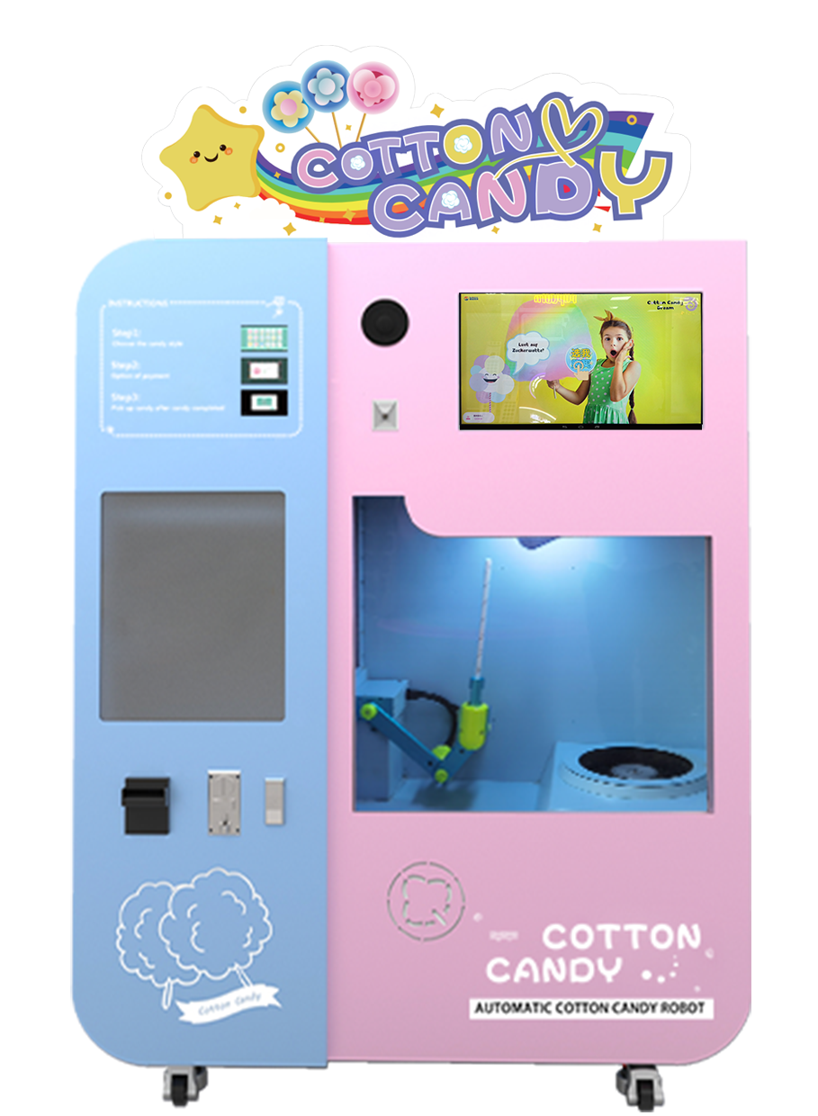
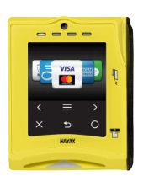
2. Machine B
Personalized light box
Operation screen (Support DIY)
Apple pay,
SAMSUNG pay...
Pressing knife
Automated Door
Burner
Manipulator
Sugar bin

Slide 6
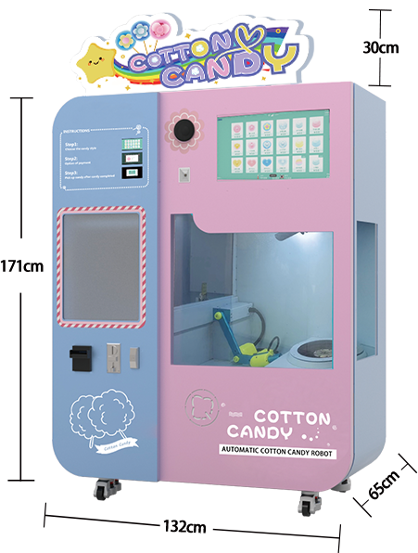
Basic parameters
Extermal dimension: 1332*671*2001mm
Machine weight: 210kg
Maximum power: 2700W
Rated Voltage: AC 220V/110V
Make Pattern: 60 Kinds
Time ofcandy making: 70-130S
Full material to make sugar: 200-250个
Use environment: 0-50℃
Due to the continuous upgrade of the equipment version, the data parameters shall be subject to the actual equipment

Slide 7

3. Flavors
60 types of flowers 4 flavors

Slide 8
4. Backend monitoring
①、Remote operation
②、Automatic power on and off
All operation functions are displayed in the background of the mobile phone.
Automatically power on and off after setting the power on and off time in the background.
③、Sales data viewing
④、Material monitoring
Comprehensive data, daily sales quantity, and revenue are clearly visible.
Real-time monitoring of materials, inventory shortage, and message warning.
⑤、Alarm reminder
⑥、Parameter setting
In case of material shortage, machine failure, etc., timely alarm reminder.
Such as language, pattern, amount, material, etc. can be set at any time in the background.

Slide 9
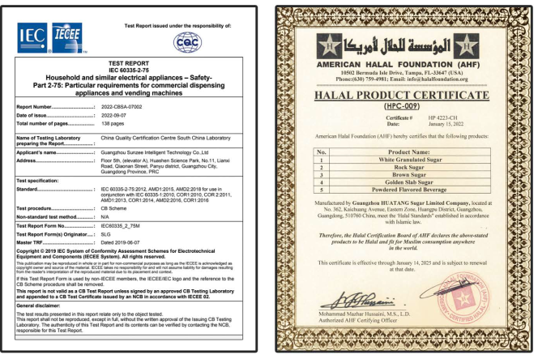
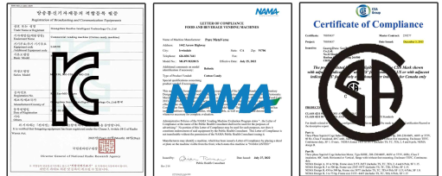
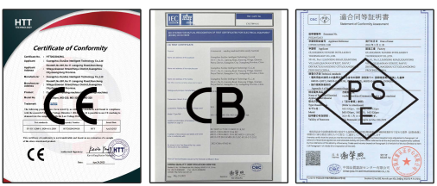
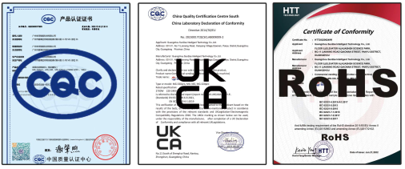
5. Certification

